Slide 1
Technical Challenge
Semantic Segmentation of Underwater Objects

Slide 2
Problem Statement
Developing an innovative CNN architecture for semantic segmentation of the under-water objects that improve flexibility for adding a new class in the classification task without having to train the entire model from scratch
Notes:
Created a labeled and segmented dataset of underwater animals for this project as well as the research community

Slide 3
Motivation
Studying about the underwater animals and their movements can help us know about the ocean waves and eventually the weather patterns
Many medicinal products come from the ocean, including ingredients that help fight cancer, arthritis, Alzheimer's disease, and heart diseases
Semantic segmentation underwater is more complex than that on the ground. Hence, we believe that this model will work well to segment complex objects on the ground as well

Slide 4
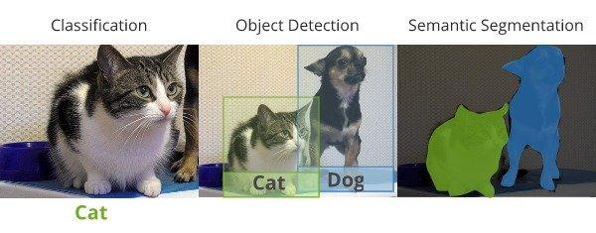
Classification vs Segmentation

Slide 5
Context of the challenge
Collection of images and labelling them for semantic segmentation task
Images collected were at different scales, different classes having same color, transparent, occluded and blurred image
Model should be flexible enough to add a new class in the classification task without having to train the entire model from scratch
Different classes of objects should be distinguishable and should have a fine boundary

Slide 6
Plan for overcoming the challenge
Used VGG-16 models for feature extraction (robust to noise, image blur)
Data Augmentation to increase training samples and train models on different orientation and effect on images
Gaussian Pyramid Image transformation to robustly segment objects at multiple scales
Atrous convolution to maintain the resolution, as rigorous convolution and pooling will cause loss of spatial information

Slide 7
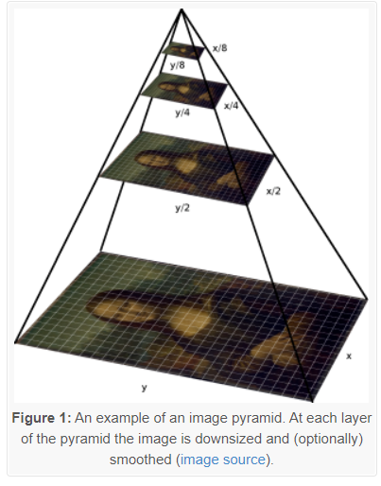
Techniques used
Gaussian Pyramid Image transformation

Slide 8


Atrous Convolution
Atrous Convolution allows us to enlarge the field of view of filters to incorporate larger context. It does not involve extra calculation
Standard Convolution
Atrous Convolution

Slide 9
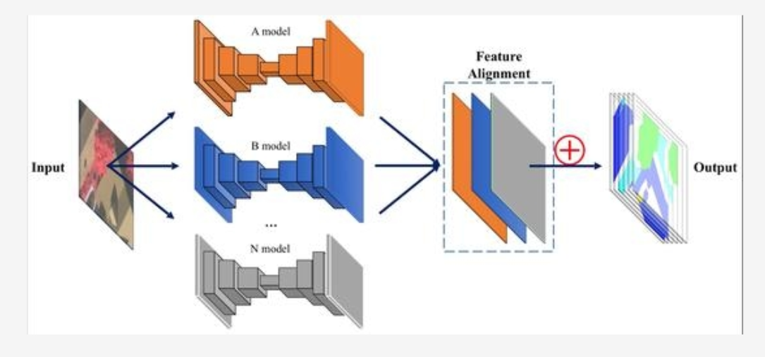
Flow Diagram of the Semantic Segmentation
Combination of
outputs of Binary Model
Binary Semantic Segmentation Models

Slide 10
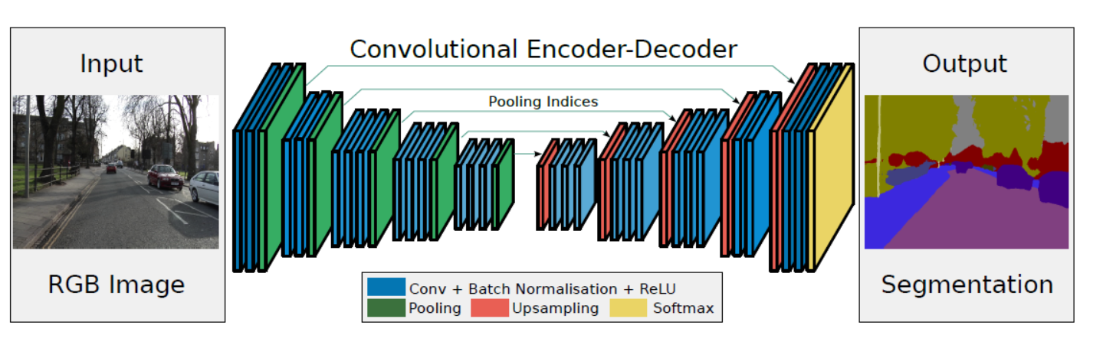
Binary Segmentation Model

Slide 11
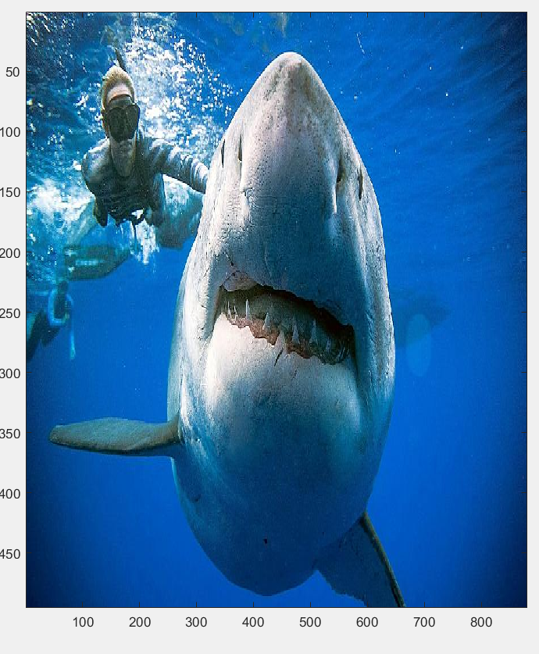
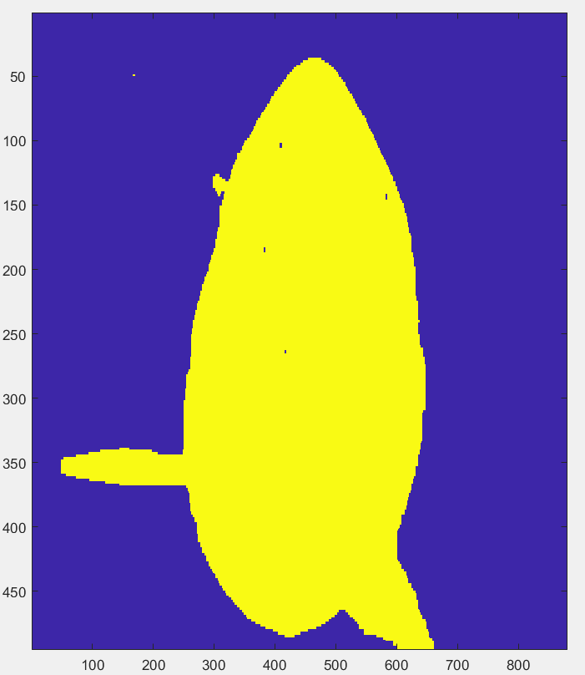
Foreground Background Segmentation for shark model
Input Image
Output Image

Slide 12
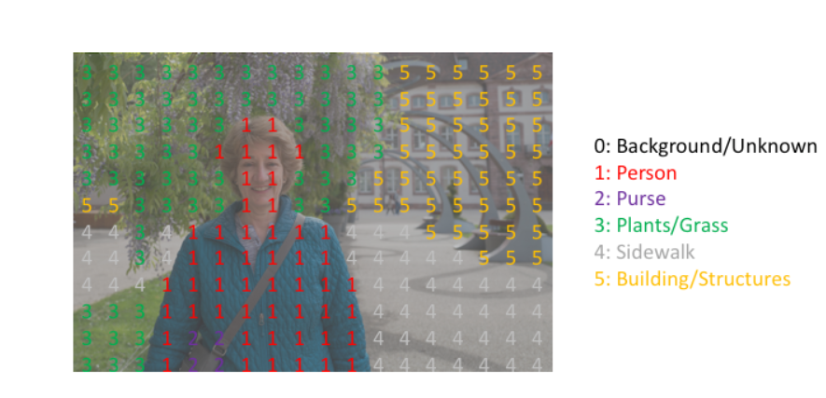
Final Output

Slide 13
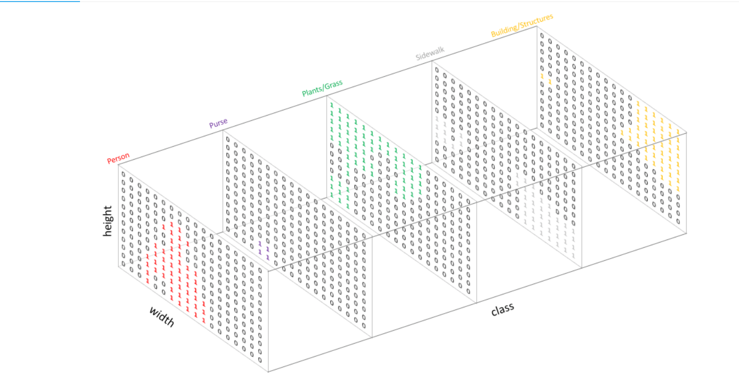
Combination of output of binary models

Slide 14
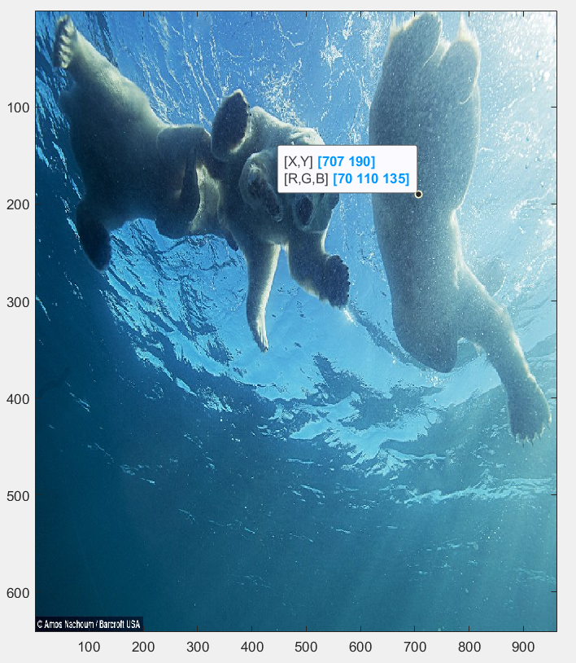
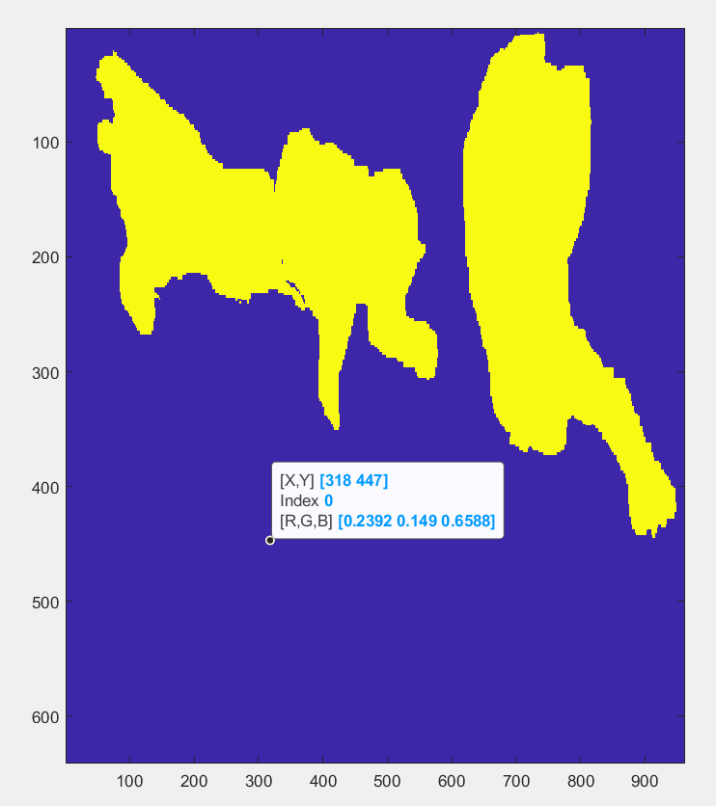
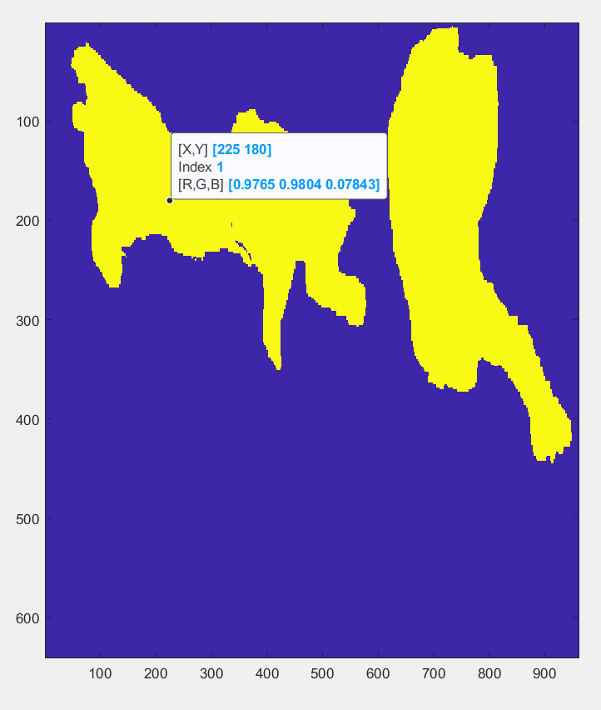
Combination of output of binary models

Slide 15
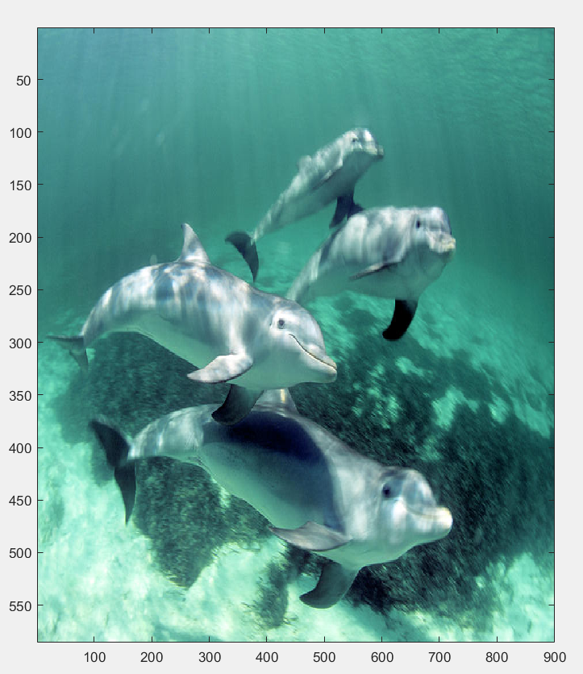
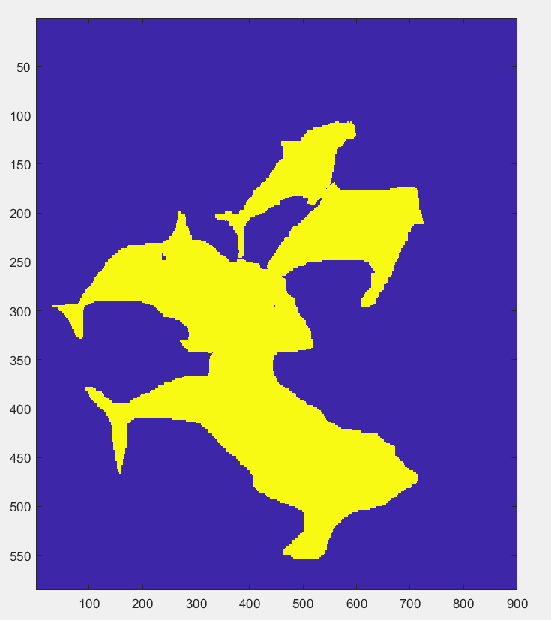
Continued
Input Image
Output Image

Slide 16
Other potential solution considered
Atrous Spatial Pyramid pooling
Conditional Random Field
Depth wise separable convolution

Slide 17
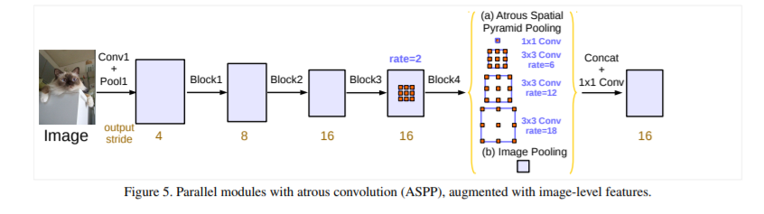
Atrous Spatial Pyramid pooling

Slide 18
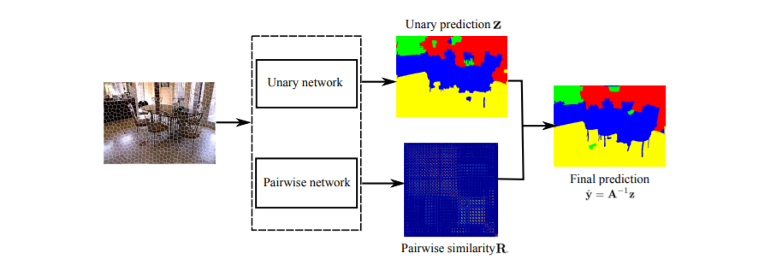
Conditional Random Field

Slide 19
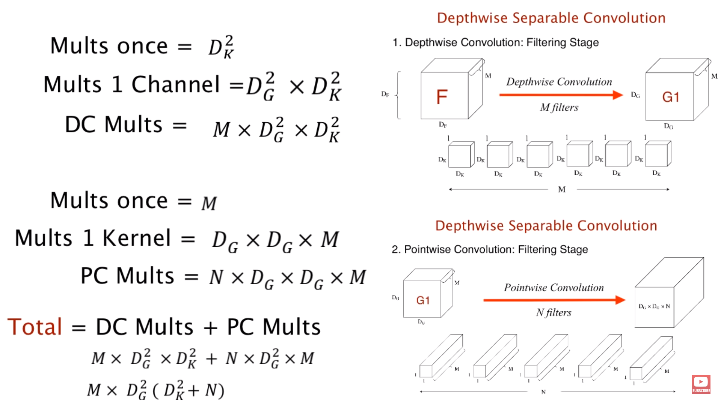
Depth wise separable convolution

Slide 20
Challenges during Implementation
Collecting data and labelling the images using ‘Label Me’ tool
Final output of the model gives the segmentation output, but it is not able to classify each pixel correctly
The model fails in the following scenarios:
Where are many classes
When there are two classes in an image having the same color
When the underwater object is transparent

Slide 21
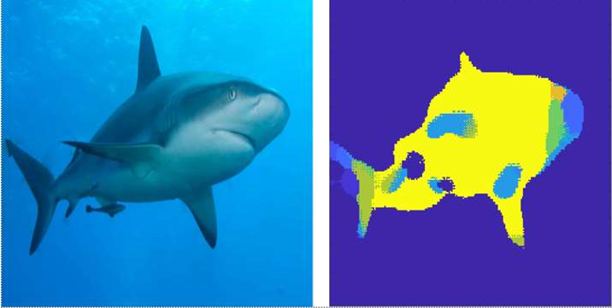
Failure Mode
Failure Mode
Input Image
Output Image

Slide 22
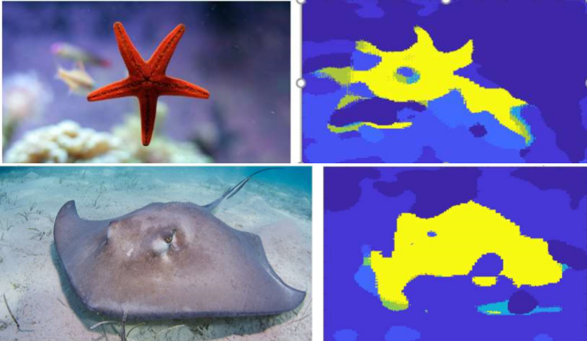
Input Image
Output Image

Slide 23
Future Scope
The proposed Semantic Segmentation system can be helpful to add a new class of objects without requiring the whole architecture to be trained from scratch. The only effort we need to put is training a binary model for the new class
Comparing it with the training the entire model from scratch, it is computationally very less expensive as well as less time taking. Involving Gaussian pyramid image processing helped to deal with the challenge caused by the existence of objects at multiple scales
There are some scopes of improvements in the output produced. With the limited resources and time, I have given my best to implement a noble idea to perform semantic segmentation

Slide 24
Conclusion
Being a graduate researcher in the Computer Vision field has enhanced my creative thinking and helped me solve technical challenges
My ongoing master’s program helped me to get comprehensive knowledge and skills in the latest technologies being used in leading industries
My work experience at Accenture made me adept at dealing with ad-hoc situations as well as obtaining leadership qualities
Overall, I strongly believe that these stages in my career has made me a versatile individual and I am sure I have the necessary capabilities to exceed expectations

Slide 25
References
[1] G. Papandreou, I. Kokkinos, and P.-A. Savalle, “Modeling local and global deformations in deep learning: Epitomic convolution, multiple instance learning, and sliding window detection,” in CVPR, 2015
[2] L.-C. Chen, Y. Yang, J. Wang, W. Xu, and A. L. Yuille, “Attention to scale: Scale-aware semantic image segmentation,” in CVPR, 2016
[3] I. Kokkinos, “Pushing the boundaries of boundary detection using deep learning,” in ICLR, 2016
[4] J. Shotton, J. Winn, C. Rother, and A. Criminisi, “Textonboost for image understanding :Multi-class object recognition and segmentation by jointly modeling texture, layout, and context,” IJCV, 2009

Slide 26
References
[5] Z. Tu and X. Bai, “Auto-context and its application to high level vision tasks and 3d brain image segmentation,” IEEE Trans. Pattern Anal. Mach. Intell., vol. 32, no. 10, pp. 1744–1757, 2010
[6] J. Shotton, M. Johnson, and R. Cipolla, “Semantic texton forests for image categorization and segmentation,” in CVPR, 2008
[7] B. Fulkerson, A. Vedaldi, and S. Soatto, “Class segmentation and object localization with super pixel neighborhoods,”in ICCV, 2009
[8] P. Kr¨ahenb¨uhl and V. Koltun, “Efﬁcient inference in fully connected crfs with gaussian edge potentials,” in NIPS, 2011
[9] X. He, R. S. Zemel, and M. Carreira-Perpindn, “Multiscale conditional random ﬁelds for image labeling,” in CVPR, 2004

Slide 27
References
[10] L. Ladicky, C. Russell, P. Kohli, and P. H. Torr, “Associative hierarchical crfs for object class image segmentation,” in ICCV, 2009
[11] Vijay Badrinarayanan, Alex Kendall, Roberto Cipolla SegNet: A Deep Convolutional Encoder-Decoder Architecture for Image Segmentation
[12] Olaf Ronneberger, Philipp Fischer, Thomas Brox, U-Net: Convolutional Networks for Biomedical Image Segmentation
[13] Liang-Chieh Chen, George Papandreou, Senior Member, IEEE, Iasonas Kokkinos, Member, IEEE, Kevin Murphy, and Alan L. Yuille, Fellow, IEEE, DeepLab: Semantic Image Segmentation with Deep Convolutional Nets, Atrous Convolution, and Fully Connected CRF
[14] Y. LeCun, L. Bottou, Y. Bengio, and P. Haffner, “Gradient-based learning applied to document recognition,” in Proc. IEEE, 1998

Slide 28
References
[15] G. Papandreou, I. Kokkinos, and P.-A. Savalle, “Modeling local and global deformations in deep learning: Epitomic convolution, multiple instance learning, and sliding window detection,” in CVPR, 2015
[16] http://labelme2.csail.mit.edu/
[17] https://www.jeremyjordan.me/semantic-segmentation/
[18] Liang-Chieh Chen, George Papandreou, Florian Schroff, Hartwig Adam Rethinking Atrous Convolution for Semantic Image Segmentation

